Slide 1
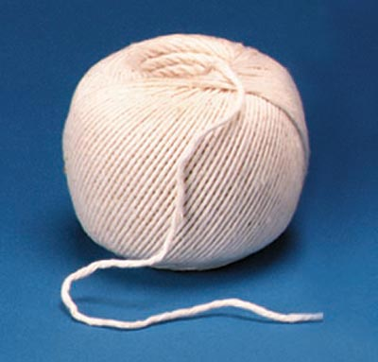

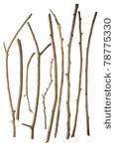

Waymarkers
For this outdoor activity, you will need :
string, scissors, chalk, twigs

Slide 2
Show Me The Way
You are going on an outdoor adventure but before you leave the classroom, remember that when you are outdoors you must follow the school’s safety rules.
Discuss the rules with your teacher.

Slide 3
Outdoors
Work in pairs
One of you is A and your partner is B
A is going to choose a destination and help B to find a way to reach it by giving verbal instructions e.g. walk straight ahead for 10 paces, then turn left - walk X number of paces…..
Swap over and practice with B giving the instructions and A looking for the destination
You are using verbal waymarkers

Slide 4
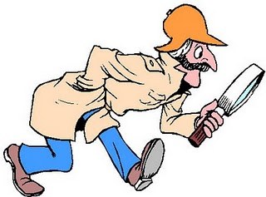
Follow the Clues
Work in pairs – one of you closes your eyes or leaves the playground while the other marks a route using the resources provided e.g. twigs, string, chalk….
Once the route has been marked out, the partner who has not been looking, tries to find the destination following the clues provided
Now swap over and try again !

Slide 5
Give Us A Clue
Go back to your classroom and discuss the activity with your teacher.
How easy was it to find the route that your partner planned?
Could you have done anything differently?
What could go wrong?
Imagine if it was raining – would chalk work?
What materials do you think would make good waymarkers?

Slide 6
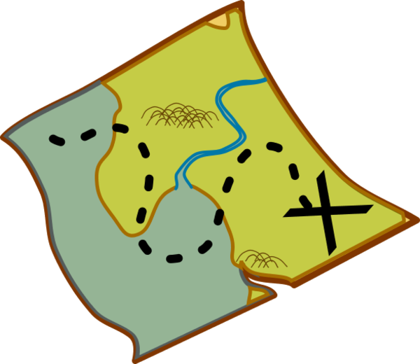
Highwaymen’s Journey
Imagine you were leaving a secret map for the highwayman
Now draw a map of your route around the playground to show him the way

